Slide 1
Reasonable and Prudent Parent Standard

Slide 2
Reasonable and Prudent Parent Standard
The Reasonable and Prudent Parent Standard allows foster parents to give their foster children permission to do age-appropriate activities that promote cognitive, emotional, physical and behavioral growth. All states are now required to promote normalcy for children in foster care.
Public Law 113-183, Preventing Sex Trafficking & Strengthening Families Act.
September 2014

Slide 3
What is the goal of these laws?
• Provide the youth with as “normal” life experience in-out-home care.
• Empower the out-of-home caregiver to encourage youth to engage in extracurricular activities that promote child well being.
Notes:
The Indian Child Welfare Act is a large piece of legislation and is written broad so that cases can be looked at individually because lots of unique situations can present themselves and attempts were made to assure cases wouldn’t be eliminated because of those unique situations.
Because the Act is large we will not be going over all of it but I would suggest that you look at it and become familiar with it especially if you are an adoptive placement.
There are 4 parts of ICWA that we are going to discuss and all resource parents need to be familiar with these areas.

Slide 4
Promoting Normalcy

Slide 5
When does the Reasonable and Prudent Parent Standard apply?
1) For extracurricular and other activities
2) For short term babysitting
DEFINITION: “Short-term” means no more than 24 consecutive hours.

Slide 6
• Allow for reasonable parenting decisions to be made by the out-of-home caregiver without waiting to obtain the social worker or Juvenile Court approval.
• Remove barriers to recruitment and retention of high quality foster caregivers.
• Reduce the need for social workers to either give permission or to obtain Juvenile Court approval for reasonable care giving activities.
• Respect the rights of youth in out-of-home care.

Slide 7
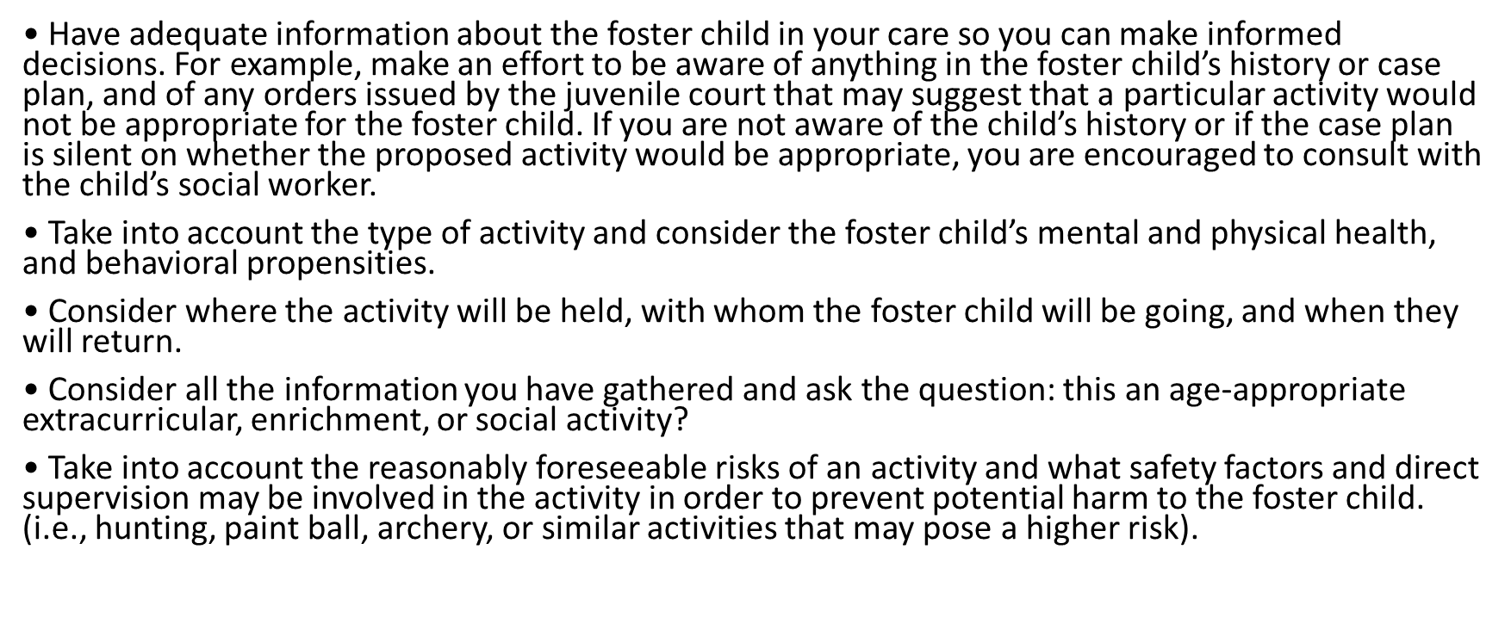
Examples of “reasonable steps” that a foster parent may take in making a determination

Slide 8
Important to Remember
This law only applies to participation in age-appropriate extracurricular, enrichment, and social activities.
This law does not apply, for example, to unsupervised time at home.
Any person having contact with a foster child for purposes other than those associated with a foster child’s participation in age-appropriate, extracurricular, enrichment, and social activities must comply with existing criminal background check requirements.

Slide 9
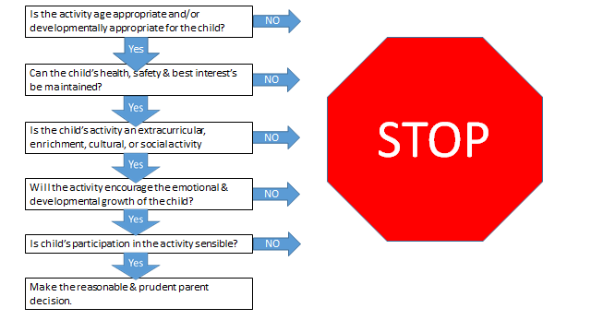

Slide 10
Video
http://www.ifapa.org/rpps/story_html5.html

